Slide 1
UIUC Letter Grades
-

Slide 2
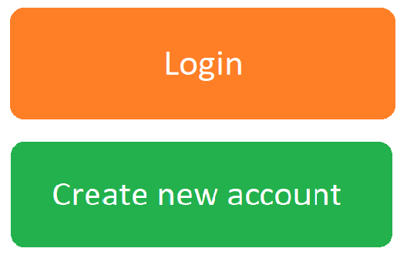
User login
Username or email
Password

Slide 3


Course Search
Saved Courses
Filter By GPA > 3.0
Filter By GPA > 2.0
Filter By GPA > 1.0
CS-124 Intro to CS: Avg. GPA 3.7
Some courses: Avg. GPA 3.02
Some courses
Some courses
Some courses
Some courses

Slide 4
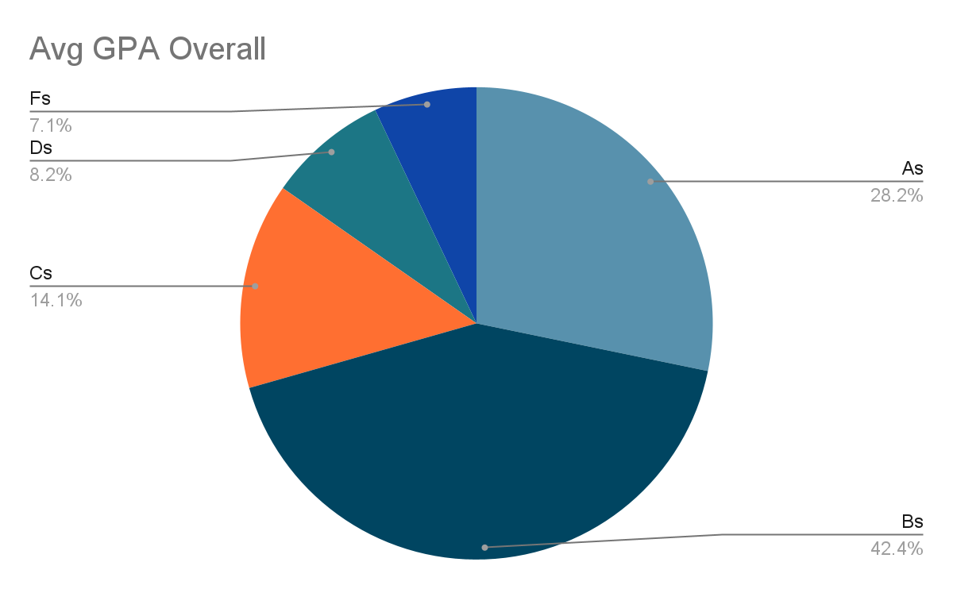
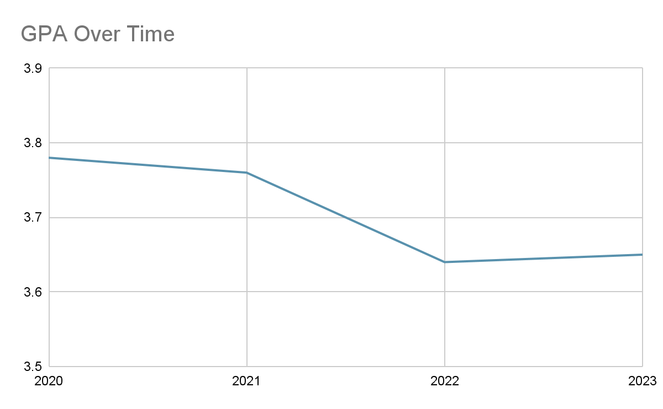
Course Search
Saved Courses
CS-124 GPA Range
Overall
3.7, Average Letter Grade is A
Save Course
2022
2021
2020
2019
The Average GPA has Decreased Over the Last Semester ↓

Slide 5
Course Search
Saved Courses
User’s saved courses
CS-124 Intro to CS
MATH 101
Remove Course
Remove Course

Slide 6
https://balsamiq.cloud/se1fdax/p7c6cep

